Slide 1
MOBILE PROXY
By
B.ARAVIND(160117737033)
N.ARUN REDDY(160117737035)

Slide 2
INTRODUCTION
This is a basic android application which solves the following problems
Getting a contact number from your phone
Getting the location of the device
To Lock the device
Change the ringer profile
All of these tasks can be done by just sending a text sms from any basic phone

Slide 3
MOTIVATION AND PROBLEM STATEMENT
When you forget your mobile at any where or you lost the mobile and want a contact, location or you want to set your mobile in ringer mode or to lock the device
You can do these 4 operations from any basic phone without internet

Slide 4


EXISTING SYSTEM FindMydevice Family Locator360

Slide 5
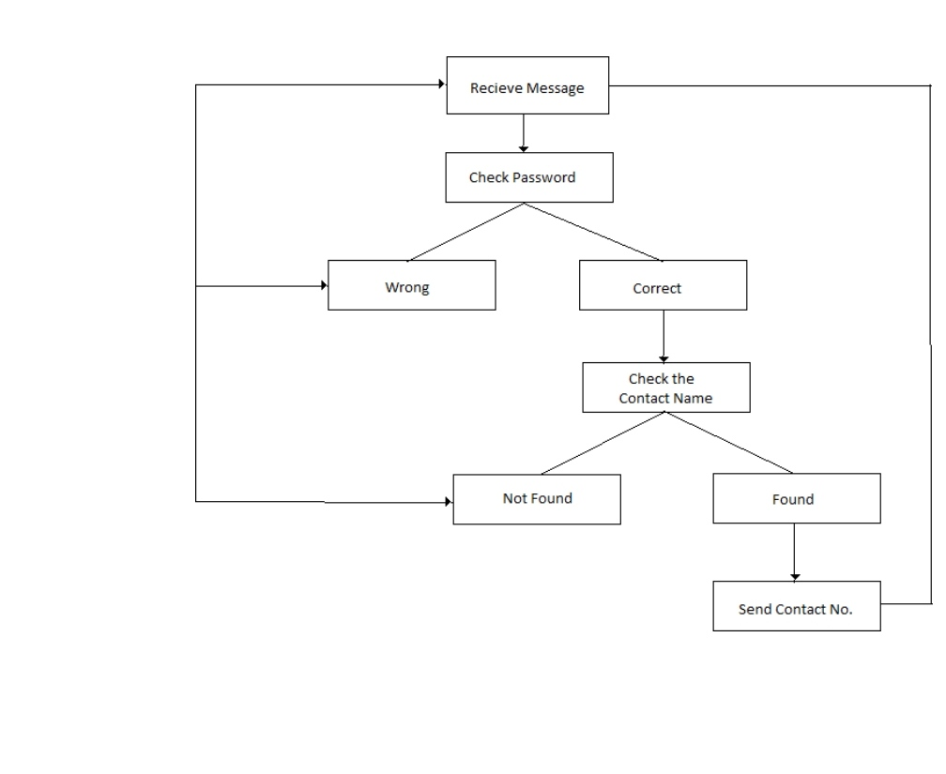
DESIGN AND IMPLEMENTATION

Slide 6
PROPOSED SYSTEM
For developing this app we used android studio 3.5
First mobile proxy should be installed on our smart phone and set password for it
From any basic phone type sms as “ password operation”,if the password u have entered is correct then operation in the android phone will be executed else just sms will be received into the mobile

Slide 7
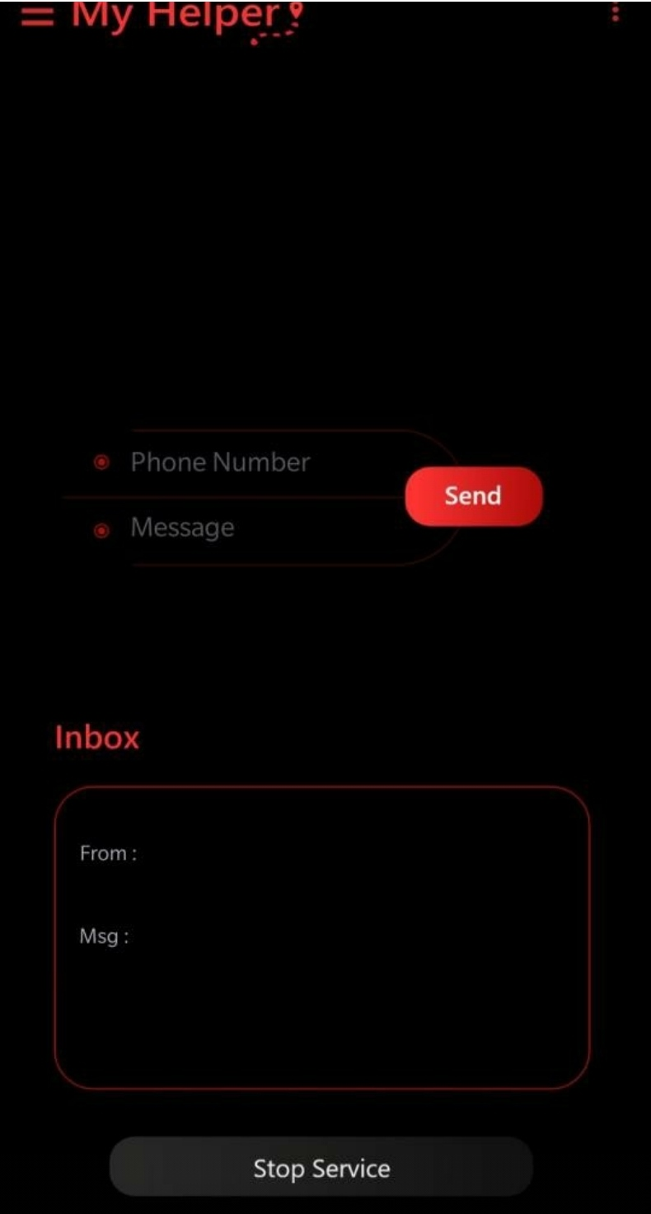
RESULTS

Slide 8
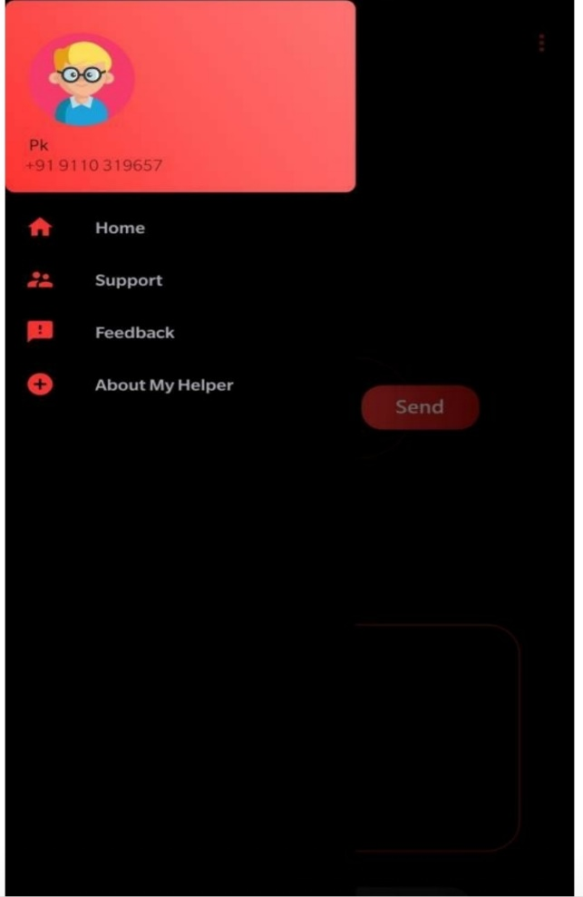

Slide 9
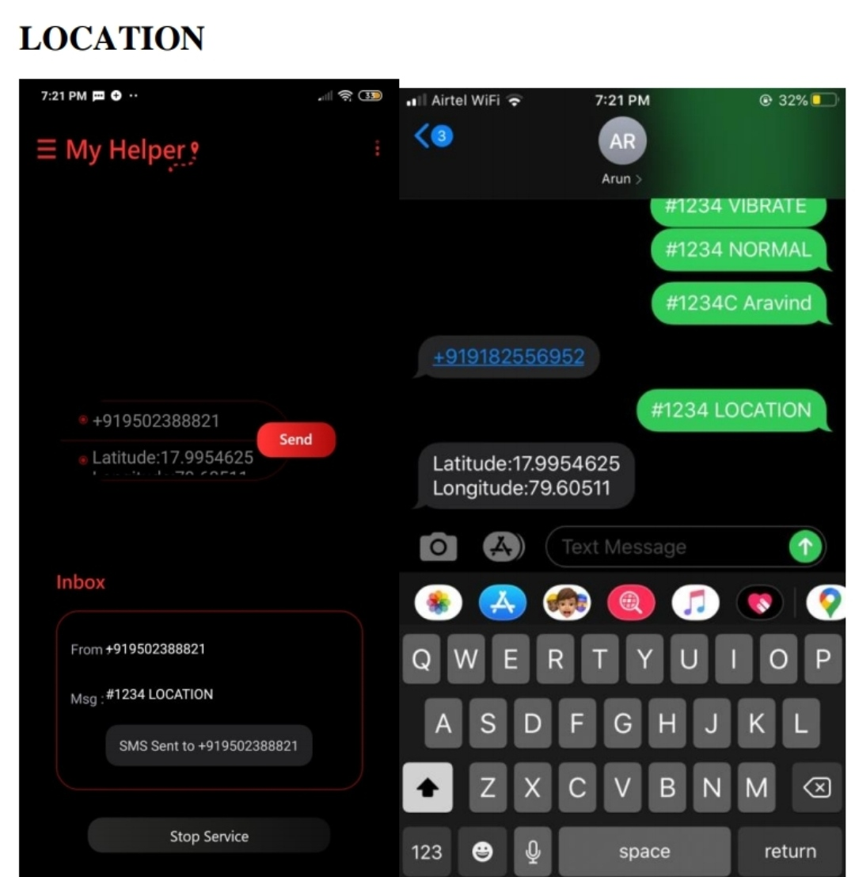

Slide 10
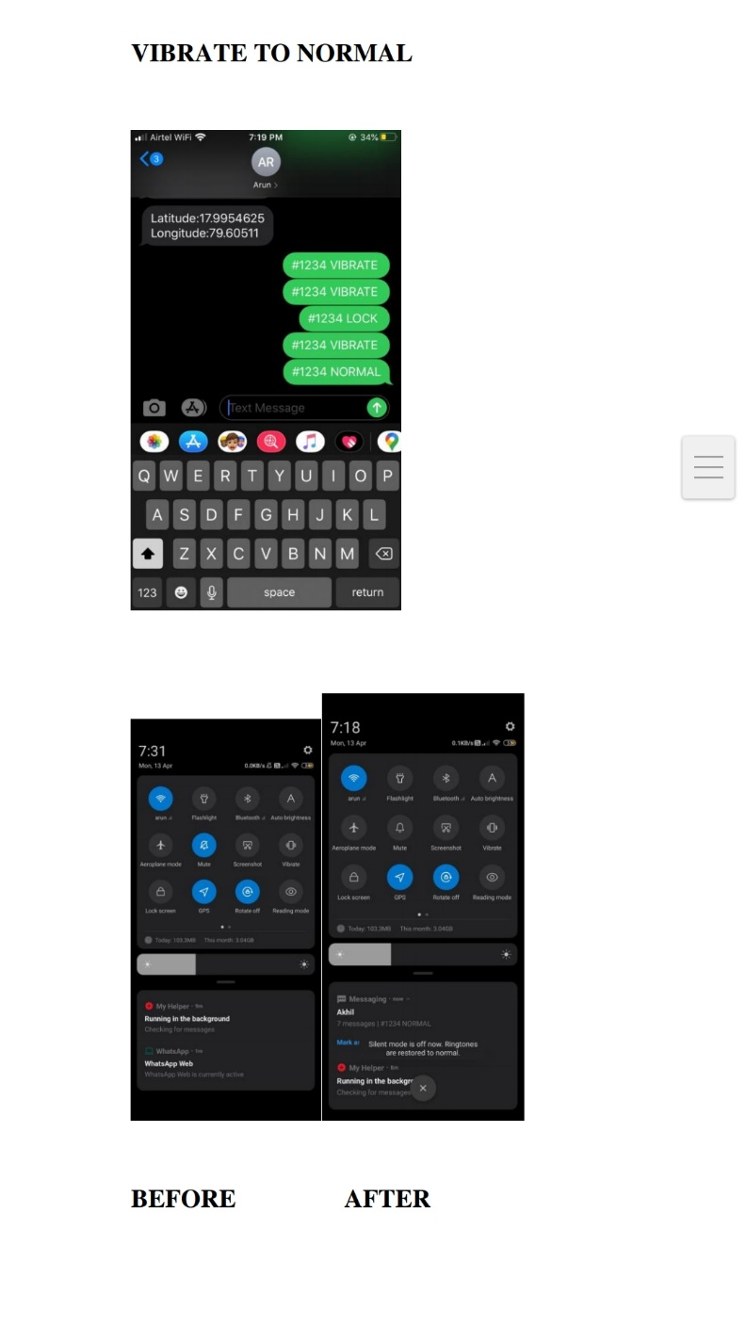

Slide 11
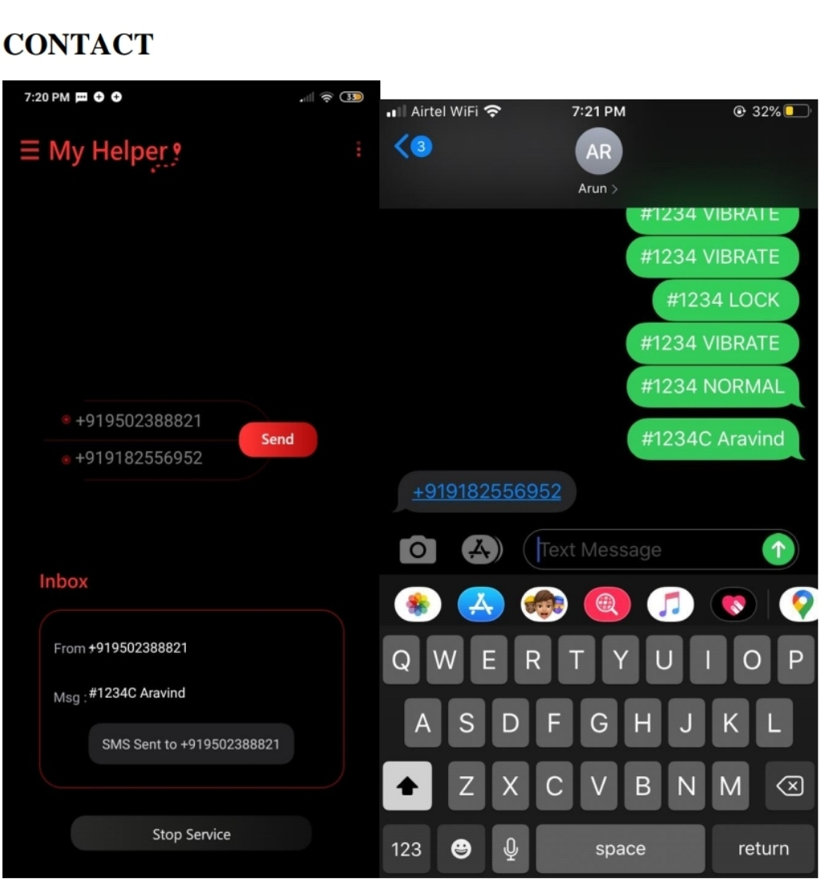

Slide 12
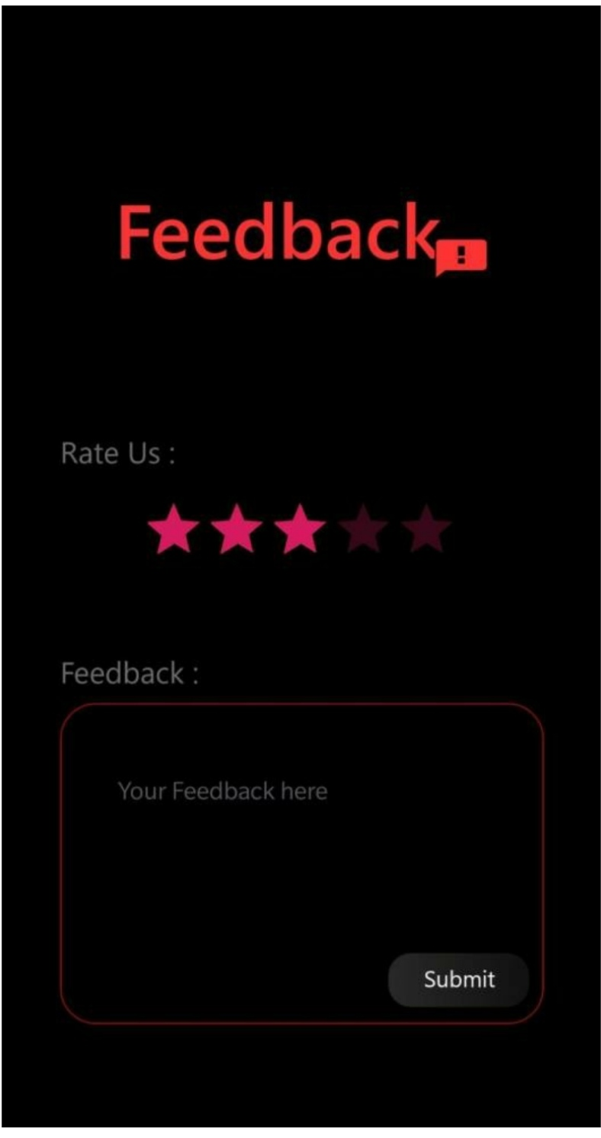

Slide 13
CONCLUSION & FUTURE SCOPE
Thus ,we built an android application which claims to solve all the four issues, due to password protection, uses can safely assure that their contacts are safe and secure also due to offline feature your works can be done quickly and effectively
In future we are going to make the app available in playstore after making improvements in UI. We are planning in reducing the battery usage and making replies faster

Slide 14
BIBILOGRAPHY
www.Wikipedia.org
www.stackoverfolw.com
www.youtube.com
www.developer.android.com

